Slide 1
Neighborhood Stability and Neighborhood Change: A Study of Housing Unit Turnover in Low-Income Neighborhoods
Brett Theodos, Claudia Coulton, and Rob Pitingolo
April 11, 2013

Slide 2
A look at Neighborhood Stability
Residential instability a concern in poor neighborhoods
Churning moves can lead to worse outcomes for families and, in particular, kids
Negative effect on collective efficacy
Resident engagement and leadership difficult to sustain
Knowing what types of households, housing units, and neighborhoods are prone to instability can guide stabilization efforts
Notes:
Note that some turnover is normal. And movement can produce vibrancy as well. But in poor neighborhoods, residential instability is often of concern.

Slide 3
Housing Unit Panel Ideal for Investigating Residential Instability in Neighborhoods
Track same units (nested within neighborhoods) over multiple waves
Turnover defined when a household moves out and another moves in or the unit becomes vacant
Allows examination of predictors at multiple levels:
Household
Housing unit
Neighborhood

Slide 4
Making Connections Survey Data
Representative sample of housing units
Wave I (2002-03)
Wave II (2005-06)
Wave III (2008-09)
9,179 housing units observed in 70 neighborhoods in 10 cities, averaging 131 housing units per neighborhood

Slide 5
Methods
Multi-level (random coefficient) logistic model
DV: housing unit turnover (individual level)
IVs:
Household: age, income, employment, financial distress, race, nativity, homeownership, subsidized rent, collective efficacy
Housing unit: single/multi-family, physical condition, proximity to commercial businesses, factories, or parks
Neighborhood: homeownership, collective efficacy, poverty

Slide 6
Target neighborhoods disadvantaged
% Poor
Average: 32.3%
Denver
Des Moines
Indianapolis
San Antonio
Seattle
Hartford
L’Ville
Milwaukee
Oakland
Providence

Slide 7
Research Question 1
How frequently did housing units turn over?

Slide 8
Over four in ten units turn over in < 3 years
Average: 42.5%
% Turnover

Slide 9
Research Question 2
How does housing unit turnover play out at the neighborhood level?

Slide 10
Using Resident Defined Neighborhoods
Providence

Slide 11
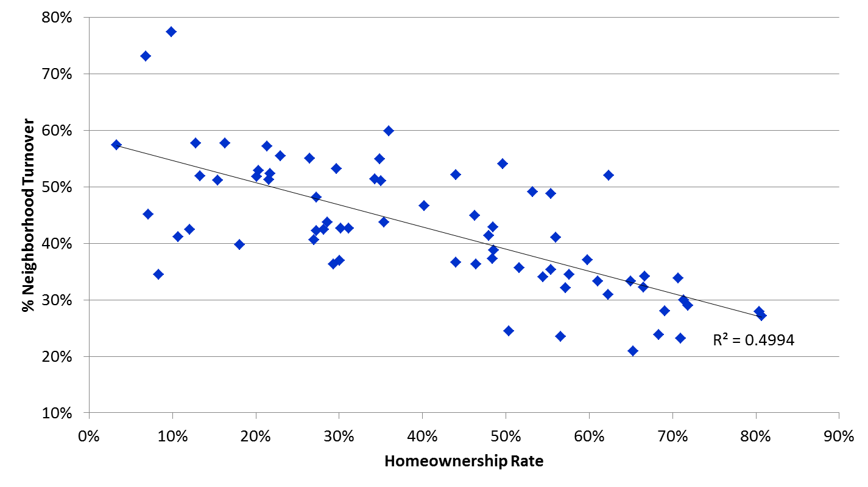
Low Turnover in High Homeownership N’hoods

Slide 12
Research Question 3
What characteristics of households, housing units, and neighborhoods are associated with the higher rates of turnover?

Slide 13
Household factors

Slide 14
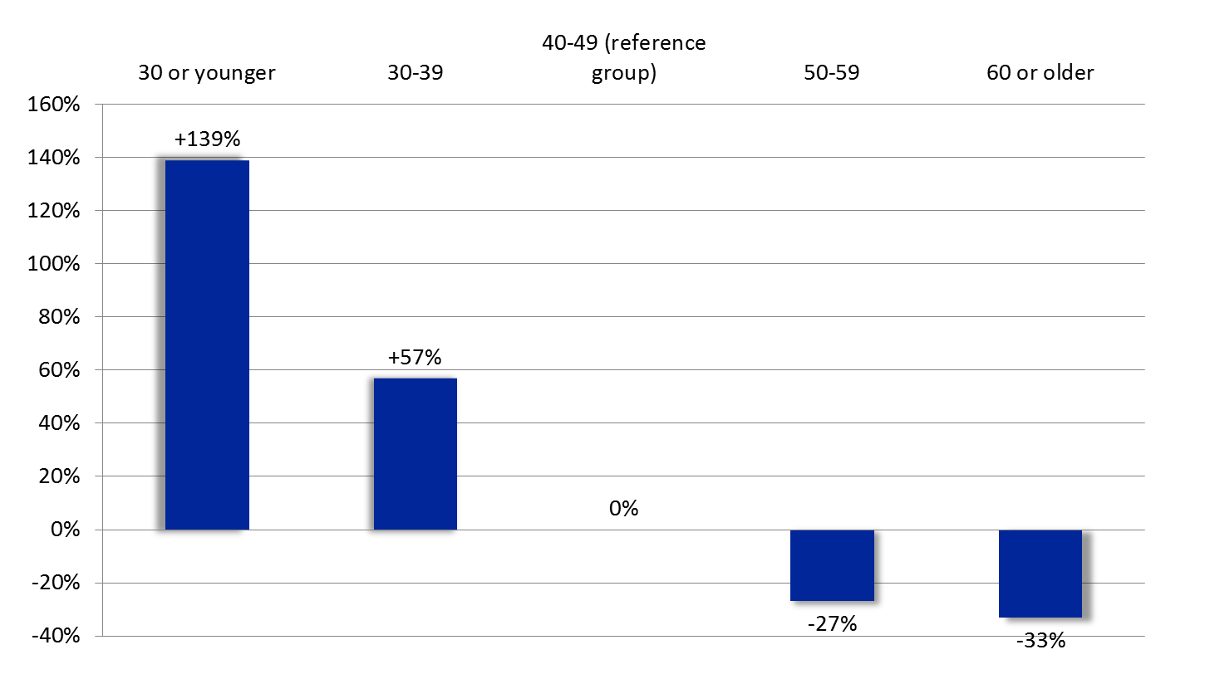
Age a big driver in turnover
Percent Increase/Decrease Likelihood Odds of Turnover

Slide 15
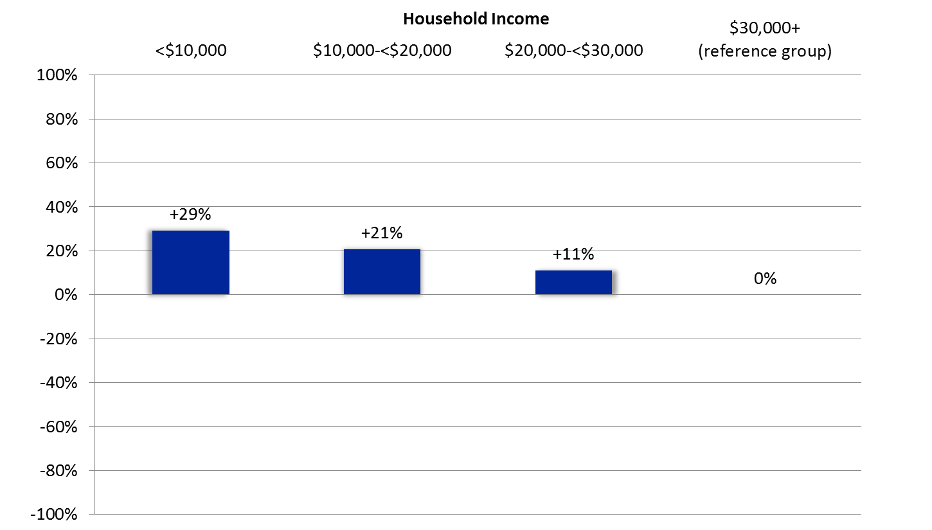
Low-income households turn over more
Percent Increase/Decrease Likelihood Odds of Turnover

Slide 16
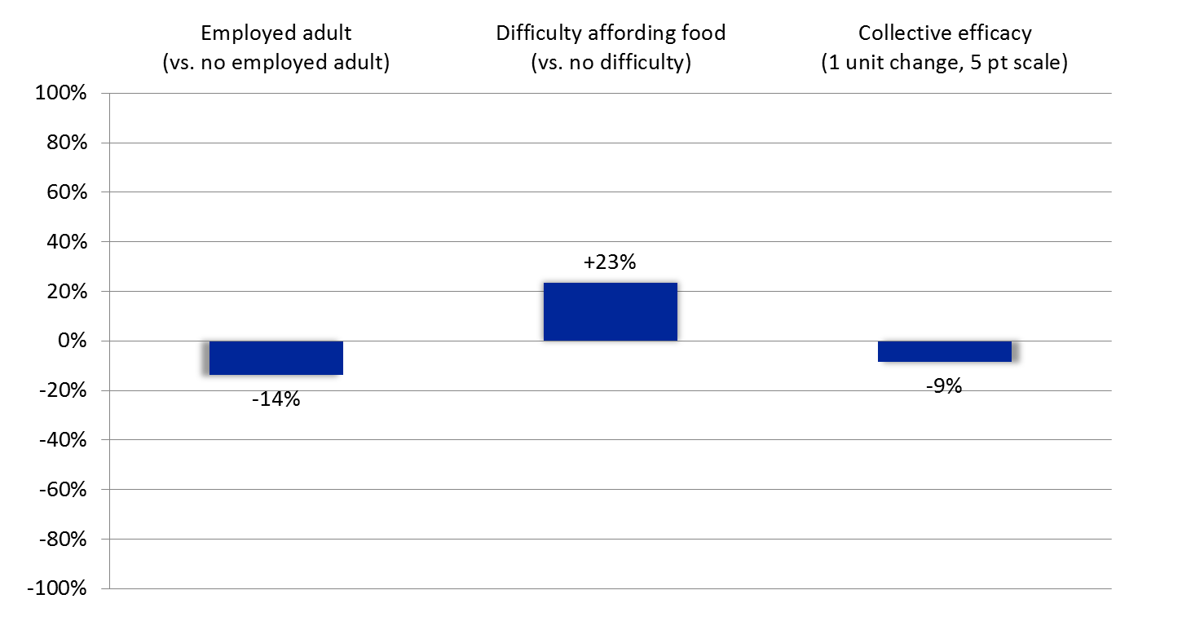
Employment, Financial Distress, and Collective Efficacy Matter
Percent Increase/Decrease Likelihood Odds of Turnover
Notes:
No difference by whether kids present or not, married or not

Slide 17
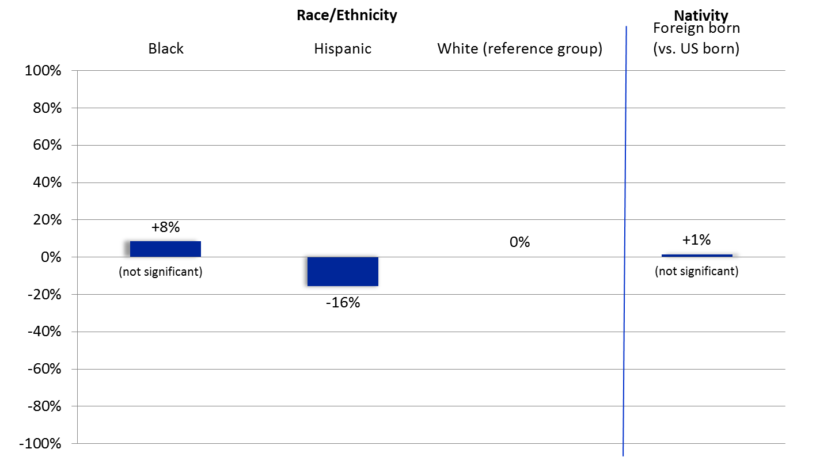
Small difference by race/ethnicity or nativity
Percent Increase/Decrease Likelihood Odds of Turnover
Notes:
No difference by whether kids present or not, married or not

Slide 18
Housing unit factors

Slide 19
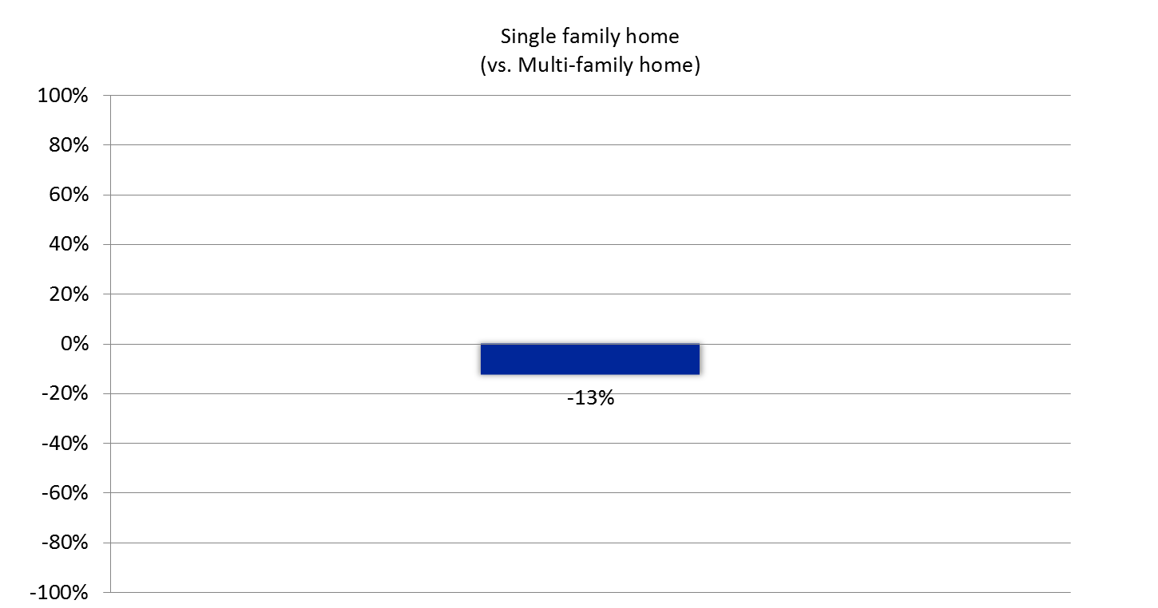
Turnover lower single-family homes
Percent Increase/Decrease Likelihood Odds of Turnover
Notes:
Other built environment factors (physical condition, proximity to commercial businesses, factories, or parks) didn’t matter

Slide 20
Neighborhood factors

Slide 21
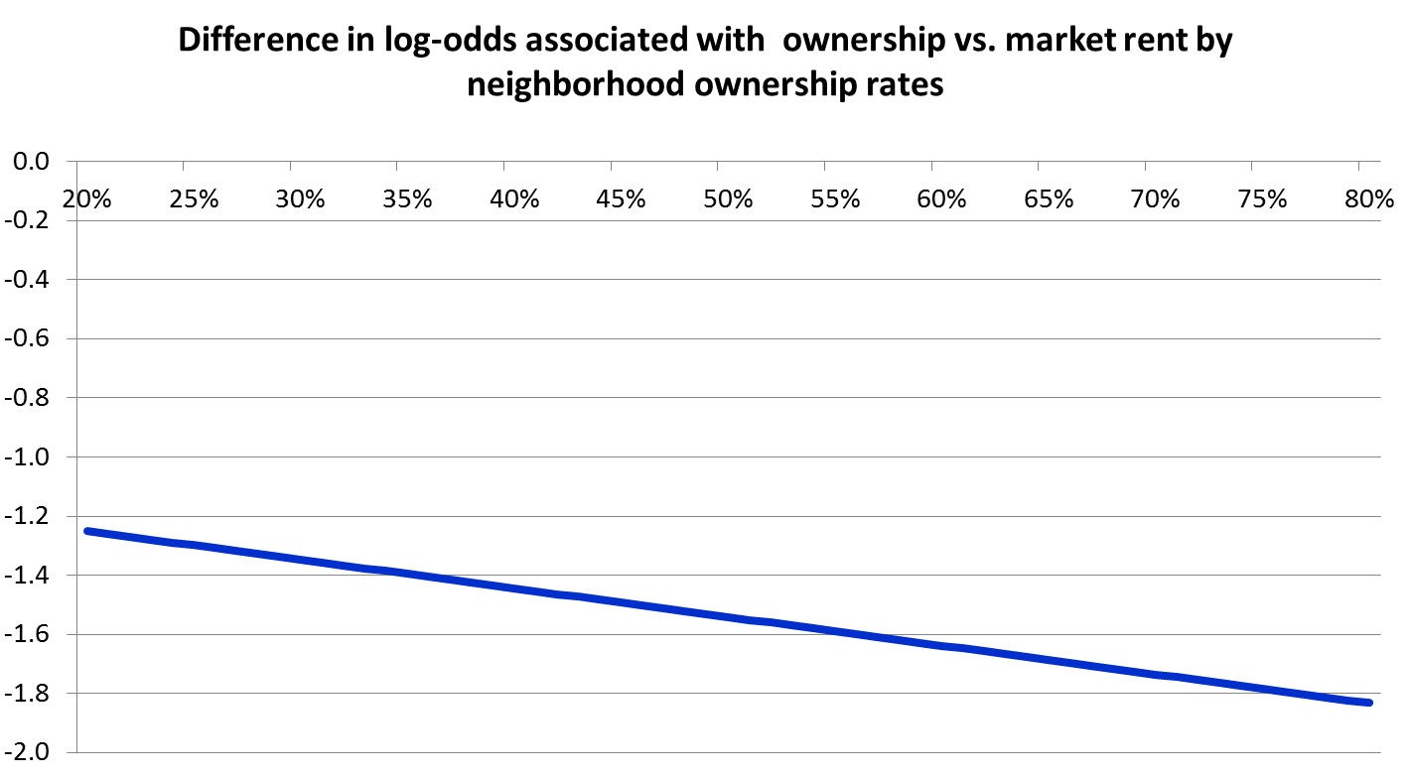
Individual & neighborhood ownership associated with less turnover
% owner occupancy
Difference in Log-odds associated with ownership

Slide 22
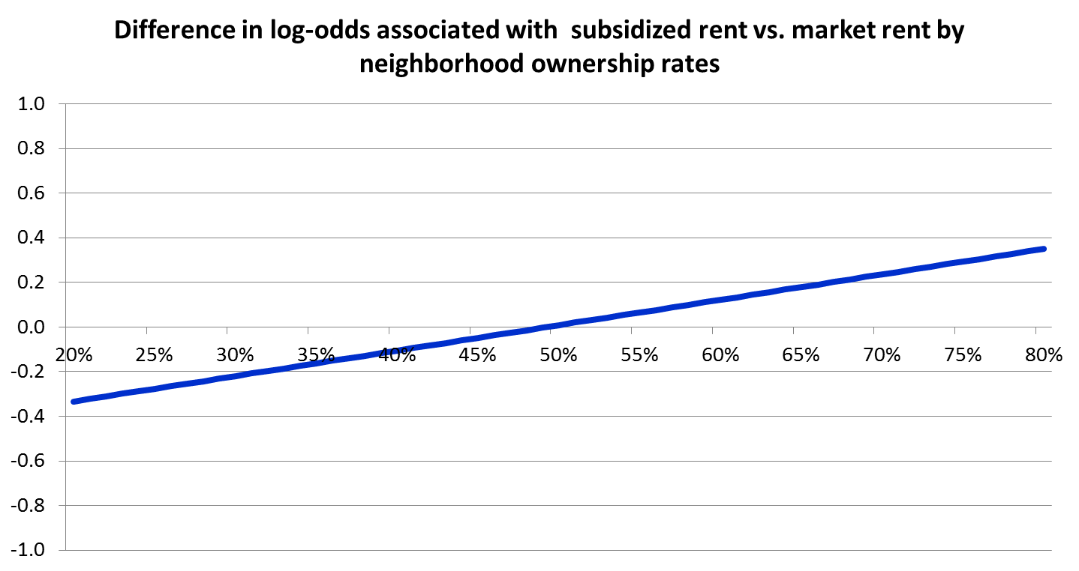
Subsidized rent protective in high rental neighborhoods, but not high owner
Difference in Log-odds associated with ownership
% owner occupancy
Notes:
Poverty and neighborhood collective efficacy don’t appear to matter

Slide 23
Recap
Poor neighborhoods experience high residential instability
Over 4 in 10 households were gone in 3 years, and more than half of households left in many neighborhoods
Age and homeownership are strongest predictive factors, but economic factors, collective efficacy, and built environment matter too

Slide 24
Implications for resilience
Subsidized housing may be platform to reduce instability
Right mix of tenure, income and age can lower neighborhood turnover, but will poor, young renter families continue to churn?
Can investments in community participation/ collective efficacy reduce instability?
Geographic concentrations of residential instability are partially explained by these factors, but contagion effects should also be explored

